Slide 1
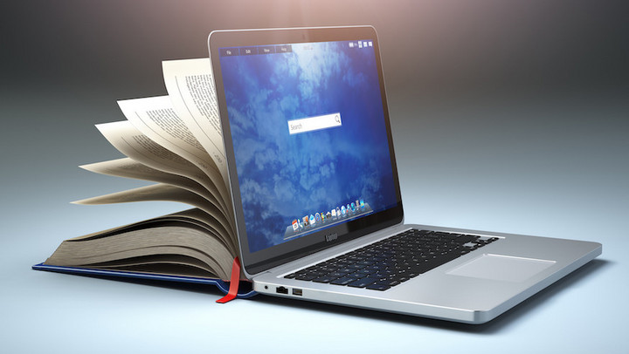
The Internet
How we use it for learning

Slide 2

What is the Internet (you can call it “The Net” instead)
The Internet is a global network which allow users who have access to any device such as mobile phones, laptops, computers, etc… to connect with each other through the Internet.

Slide 3
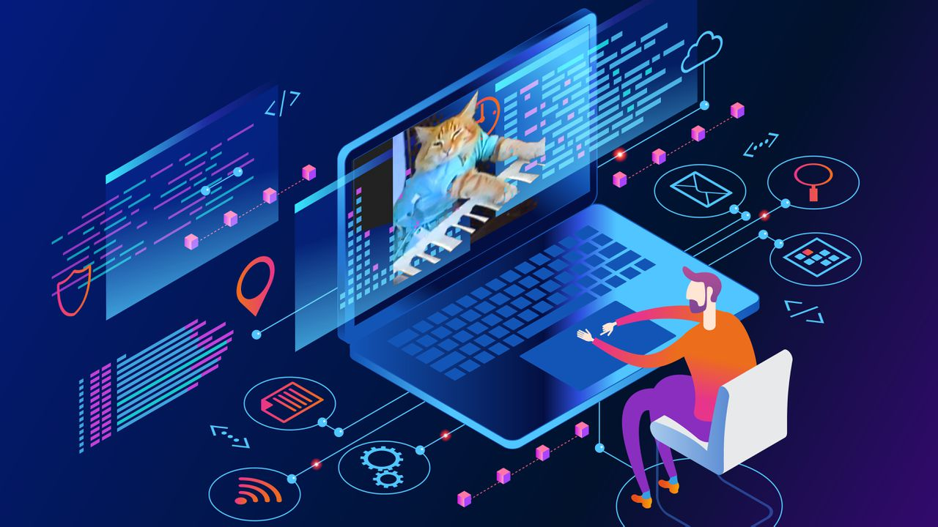
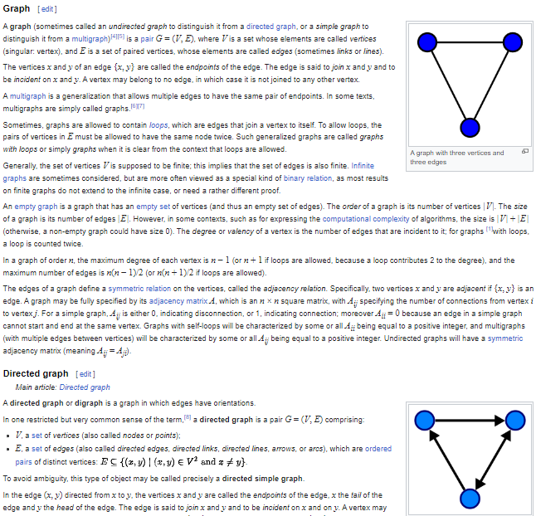

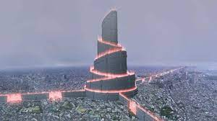
What we can do with the Internet
- Find lots of resource kinds such as:
documents,
image,
audio
- Share your things to the others.
- Sometimes, you are able to use resources without downloading them to your computer
- Contact with your friends online

Slide 4
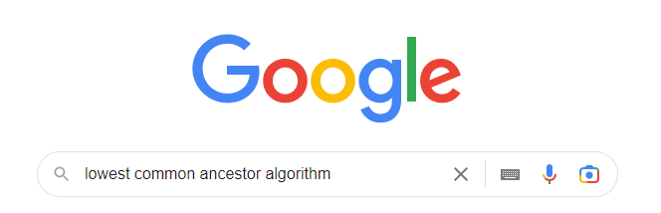
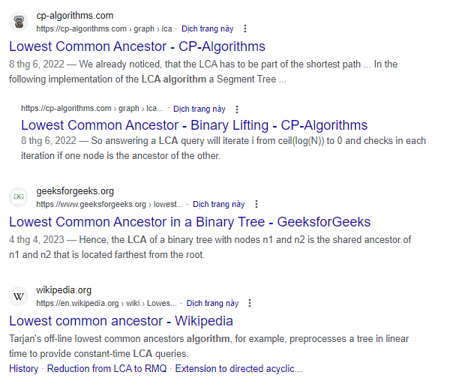

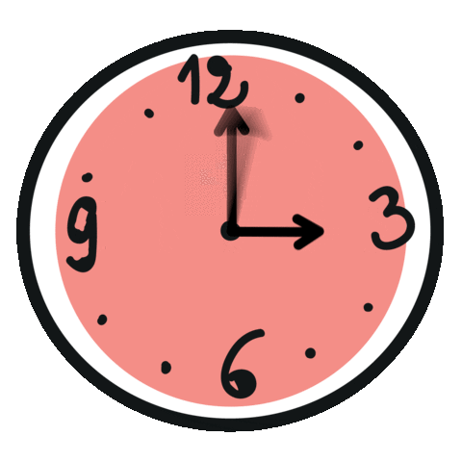
Benefits of the Internet in Learning
1. Finding information on the Internet more easily

Slide 5
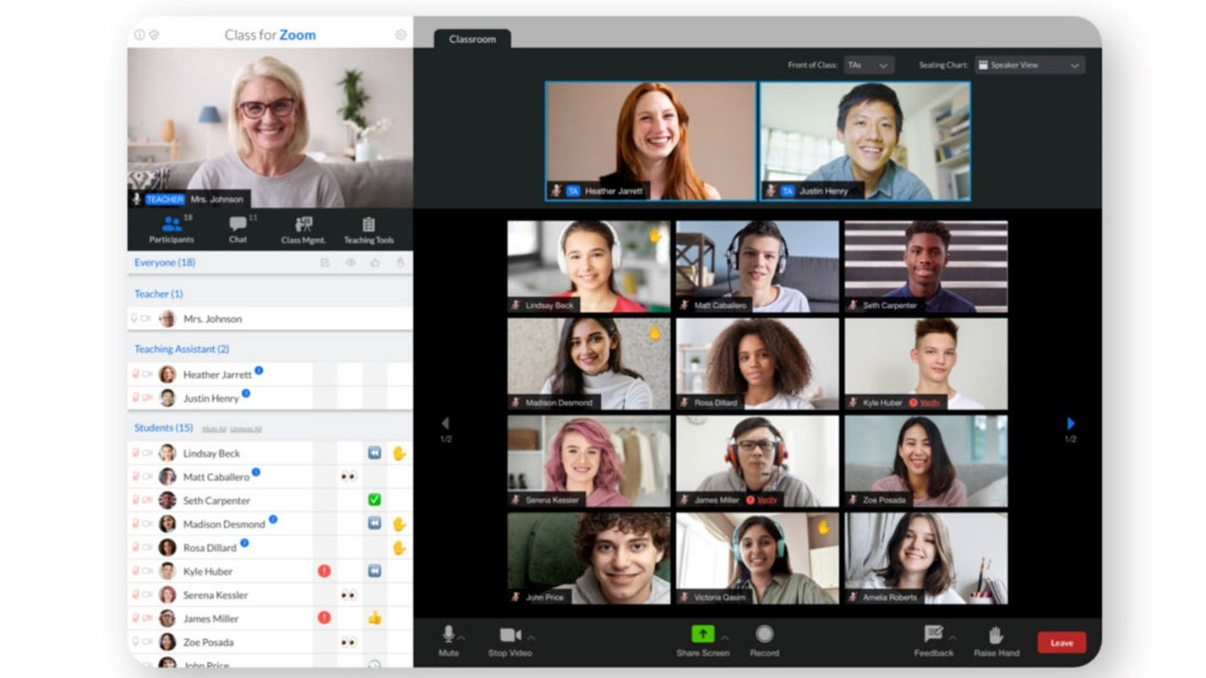
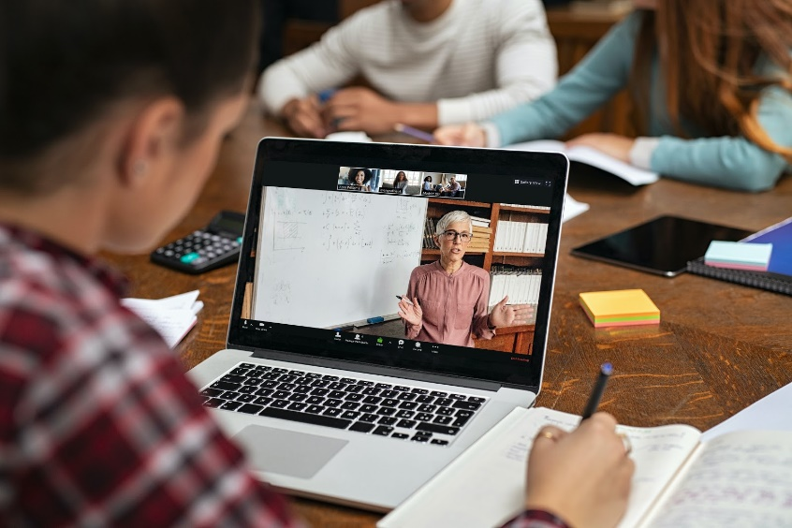

Benefits of the Internet in Learning
2. Online Learning

Slide 6
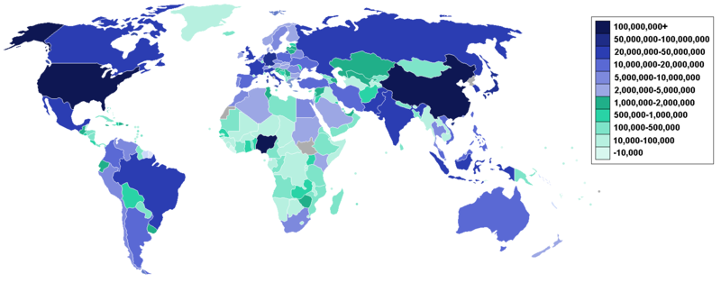



Benefits of the Internet in Learning
3. Up-to-date Information

Slide 7
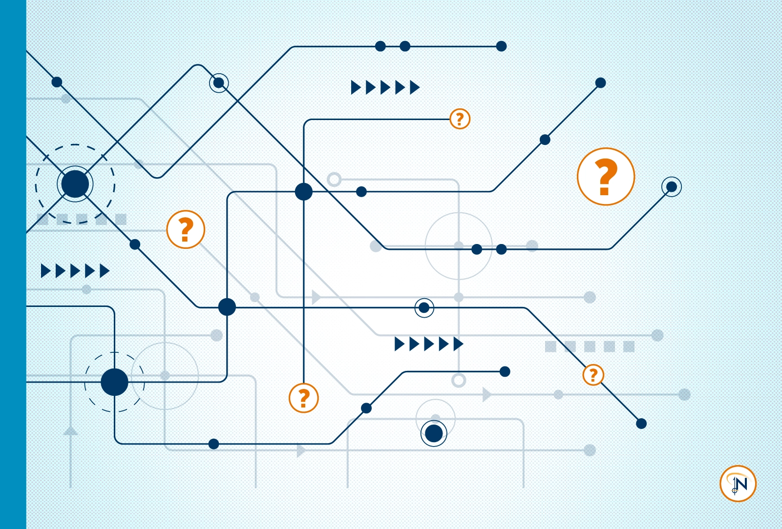


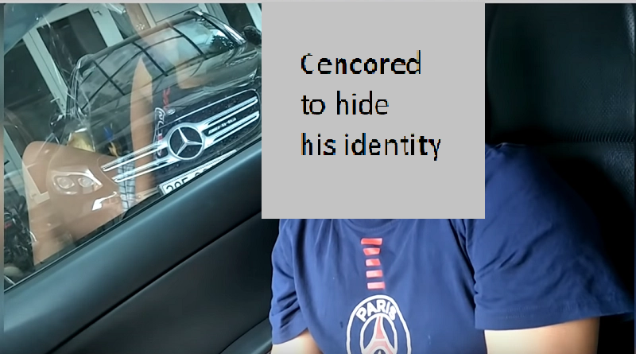
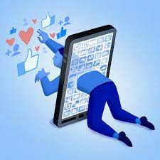


How to use the Internet effectively
(Things to avoid)
- Be aware of the dark contents
- Stay away from contents which traumatize some individual
- Distinguish between real news and fake news and avoid scams
- Avoid being addicted to social media

Slide 8
How to use the Internet effectively
(Things to do)
- Find the reliable resources
- Find student forums
- Gain some knowledge from experienced people
- Share your opinion or doubt to other confidently

Slide 9
